Slide 1

Windows Forms- DB Processing
Many of the Point of Sale type of processing requirements are generic to most applications

Slide 2
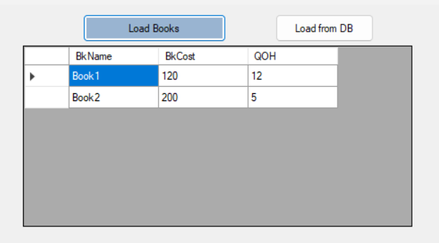
The Interface – Windows Forms & the GridView
The quickest way to explore a Girdview: Get data, get the gridview and hook them up
Many ways to get data – as simple input, via a data structure such as an array – easiest however is via a List
Declaration for a List: List<T> nameList = new List<T>();
So for example, let us create a class named Book; let’s create a few books and add some book data
Book b1 = new Book() { BkName = "Book1", BkCost = 120, QOH = 12 };
Book b2 = new Book() { BkName = "Book2", BkCost = 200, QOH = 5 };
Now let’s create a List data structure to hold these books…
List<Book> books = new List<Book>();
And let us add some books into the List data structure
books.Add(b1); books.Add(b2);
Drag and drop a Gridview onto the form; create an event to display the books onto the Gridview – this could be a button_click or a Form_Load….and hook up the List of Books to the GridView and you are done
dGV1.DataSource = books;
class Book
{
public string BkName { get; set; }
public decimal BkCost { get; set; }
public int QOH { get; set; }
}

Slide 3
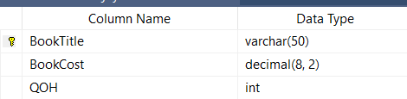
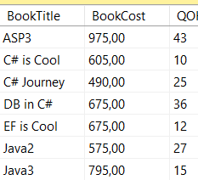
How to Get Data from a Database
Place Data into the database inside a Table named Book and add some data
Open Windows forms app
Once the form loads, make use of the following objects:
Connection String + Query String
SqlDataAdapter – uses the Connection String and Query String to get the Data from the DB
DataTable object – an “in-house” data structure to represent the DB inside your Windows forms application
Fill method of the TableAdapter to fill data into the DataSet
string connString = "Data Source=146.230.177.46\istn3;Initial Catalog=xxxxx;User ID=xxxxx;Password=yyyyy";
string queryString = "SELECT * FROM Book";
SqlDataAdapter taUser = new SqlDataAdapter(queryString, connString);
DataTable dtBook = new DataTable();
daBook.Fill(dtBook);
dataGridView1.DataSource = dtBook;

Slide 4
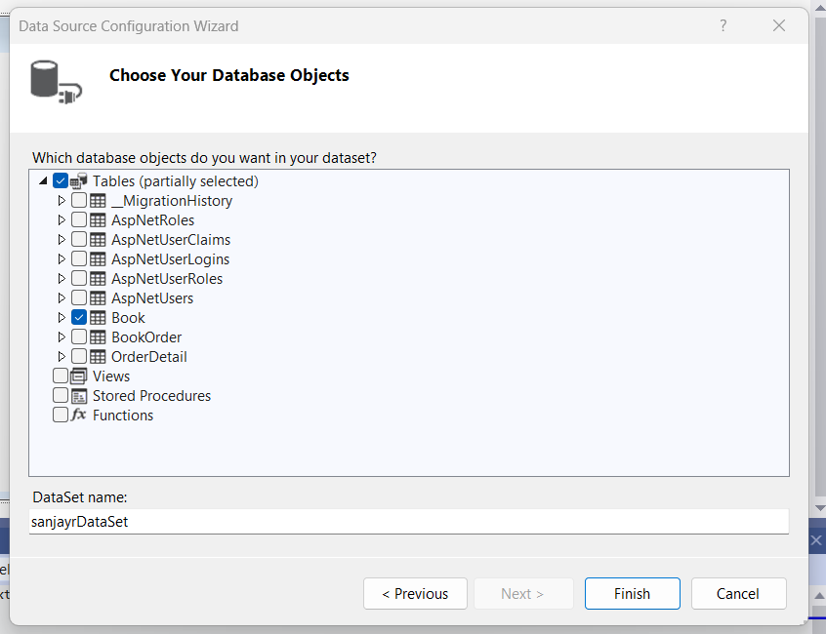
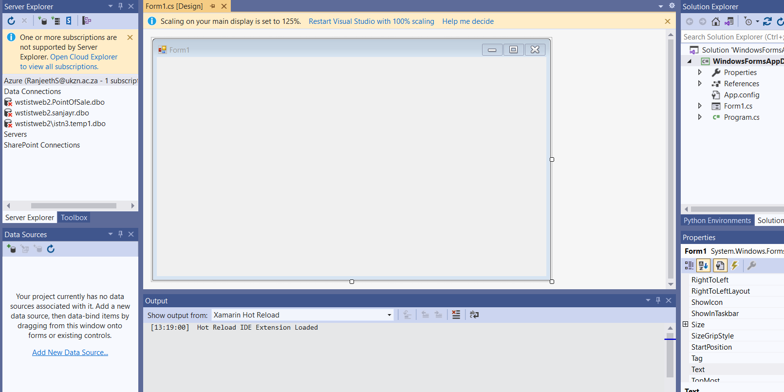
How about the Database – Version 2?
Make use of the tools, wizards and drag and drop and craft the solution rather than code it
There are 2 ways to do this:
Half Drag and Drop and Half Code:
Method 1: Half Drag and Drop:
Drag a new DataSet onto the Solution Explorer and point it to the database table;
Add a New Data Source

Slide 5
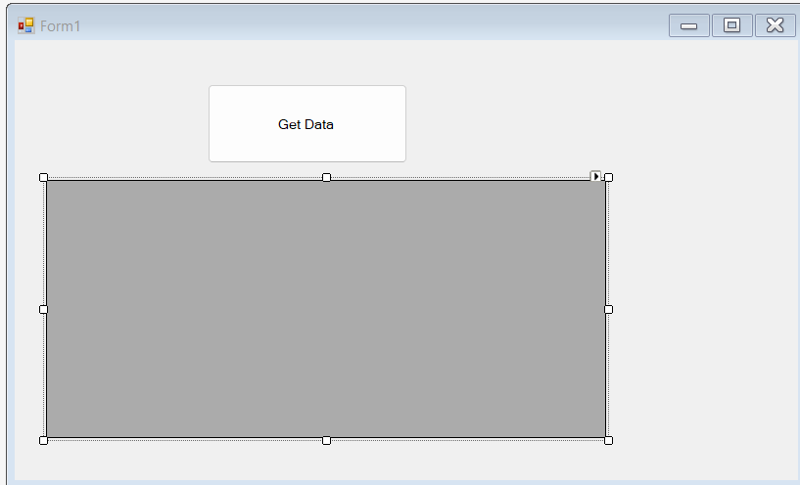
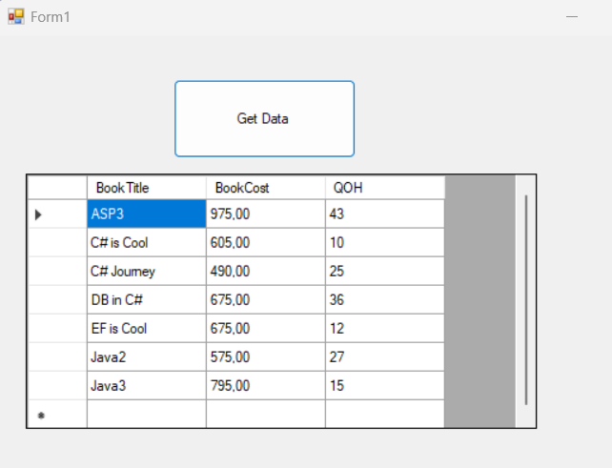
So now you have a DataSet Class
This class has to be activated → turned into an object – 2 paths to do this:
1st Path:
DataSet dsBooks = new sanjayrDataSet();
sanjayrDataSet.BookDataTable bkDT = new sanjayrDataSet.BookDataTable();
sanjayrDataSetTableAdapters.BookTableAdapter bkTA = new sanjayrDataSetTableAdapters.BookTableAdapter();
Now add the GUI elements such as a DataGridView and a Button
In the event handler section of the button….add the following code:
bkTA.Fill(bkDT);
dGV1.DataSource = bkDT;
And you are done – the connection string part is handled by the data connection wizard

Slide 6
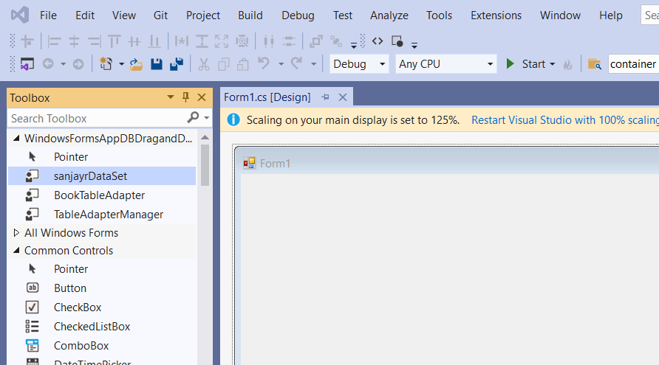
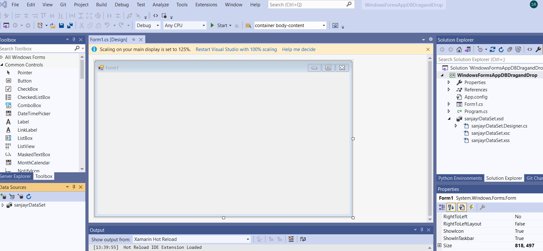
The Problem with the Coding Route
The Design View is blocked and you can only control the design of the DataGridview via code
What is the alternative – do everything via drag and drop
The Drag and Drop Pathway
Once you have a dataset class → Rebuild the application → this will create the objects and place them in the toolbox

Slide 7
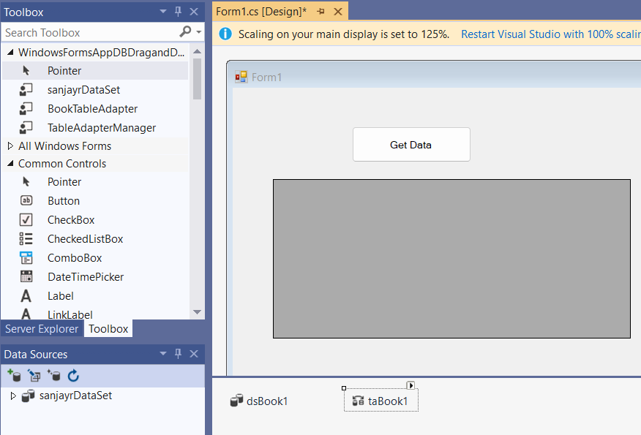
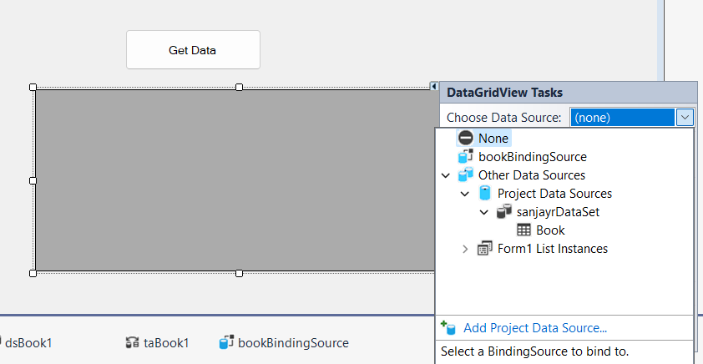
Make the Object Available
Drag and drop the objects into the tray of the form…Load the data via the table adapter fill method → taBook1.Fill(dsBook1.Book); …and hook up the DataGridView and you are done…One line of code!!!

Slide 8

POS – DB Processing
Why Point of Sales?
It has all the ingredients required to understand software development that involves database processing
In class – 2 applications will be presented
Point of Sale System
Reservation System
The Point of Sales (POS) discussion will culminate in the computer programming test
Prac 3 is a sample of the 1st part of that test

Slide 9
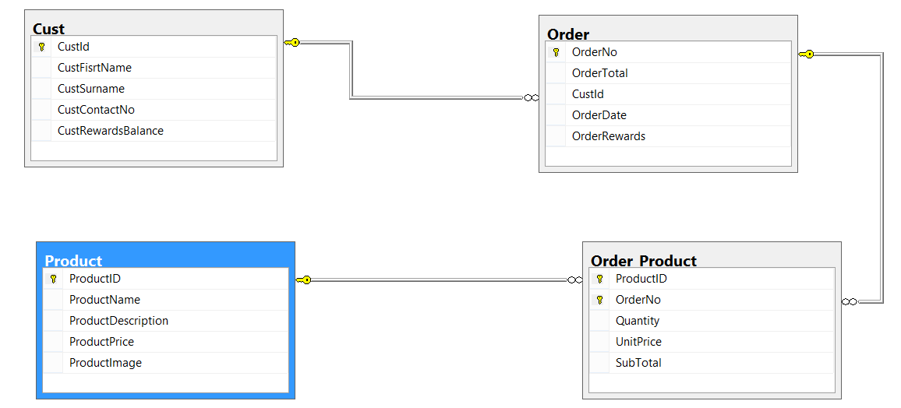
POS – DB Processing
A typical POS – the customer has the focus –
Strategy for a scaled down POS– find the customer; find the product; add it to the order; confirm the order
Once this is done – we will move onto a POS where the customer will be able to purchase more that one product

Slide 10
INSERT INTO Cust
(FirstName, Surname, email, ContactNo)
VALUES (@FirstName,@Surname,@email,@ContactNo);
SELECT CustId, FirstName, Surname, email, ContactNo, Rewards FROM Cust WHERE (CustId = SCOPE_IDENTITY())

Slide 11
POS – DB Processing-The Search
The idea is to configure the SELECT query of the TA so that the data that is extracted from the database matches the search criteria that you will enter.
Remember the default arrangement is that all records are returned … however now you will restrict the number of records that are returned to the dataset from the database
The SELECT query has to be changed to include a WHERE clause….
SELECT CustId, FirstName, Surname, email, ContactNo, RewardsBalance
FROM Cust
WHERE (Surname LIKE @surname + '%')

Slide 12
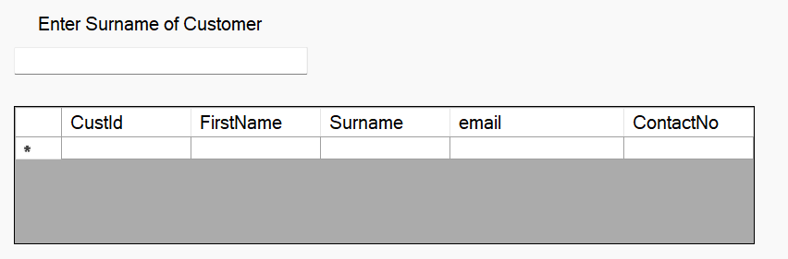
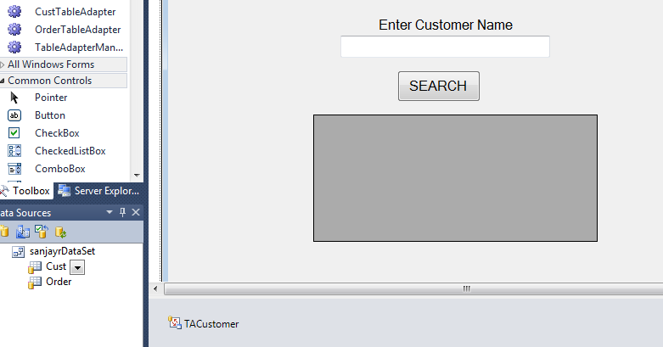
POS – DB Processing-The 1st Form
Add a new Windows form to your application and make it the start-up form
The GUI will consist of a textbox where the user will input his/her search criteria… in our case, this will simply be the customer name
If an exact match is obtained, then all matching records are returned. Since there is the possibility of returning more than one record, the GUI control that will be used to display the returned record(s) has to be chosen so that it could display more than one records
The ideal choice in this case is the datagrid. Hence the GUI will look like…also, we will need a TA that will be responsible for “getting” the data that matches our search criterion ,from the database
The “trigger” for the search could be a button or simply any character typed into the textbox

Slide 13
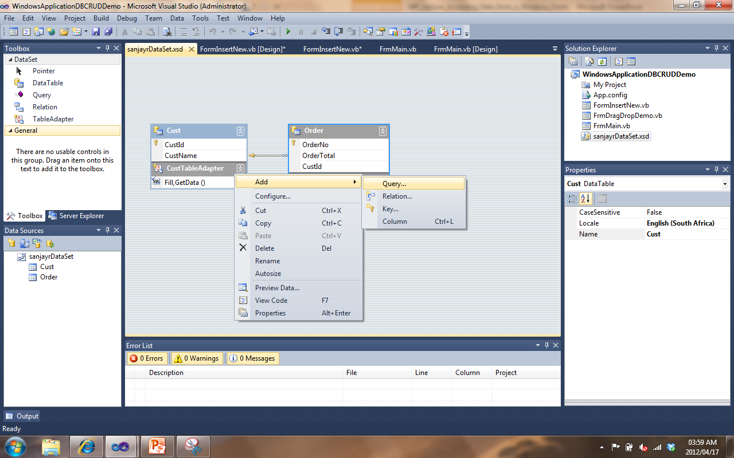
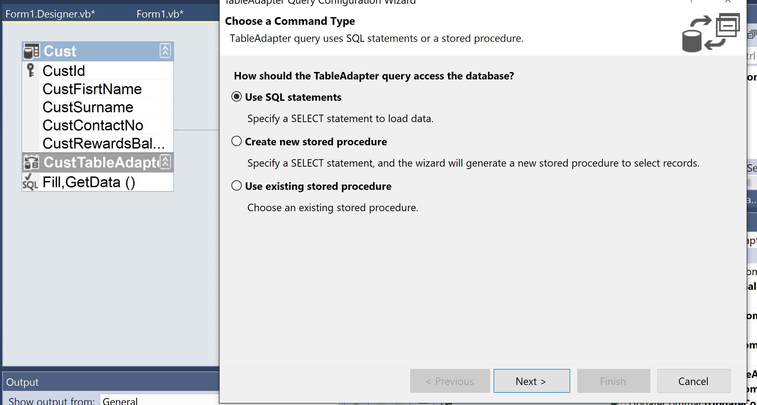
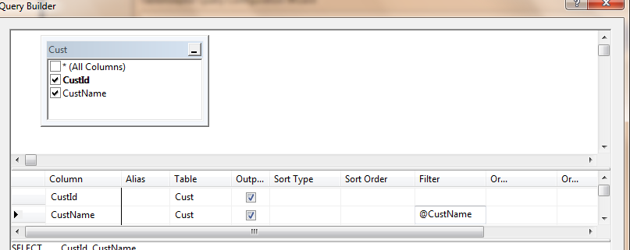
POS – DB Processing-the Table Adapter and the Query Builder
These are hugely important “strings to your bow” as you try to obtain control over the database … The filter simply takes in a variable name prefixed by the @ sign and generates the SQL statement for you.

Slide 14
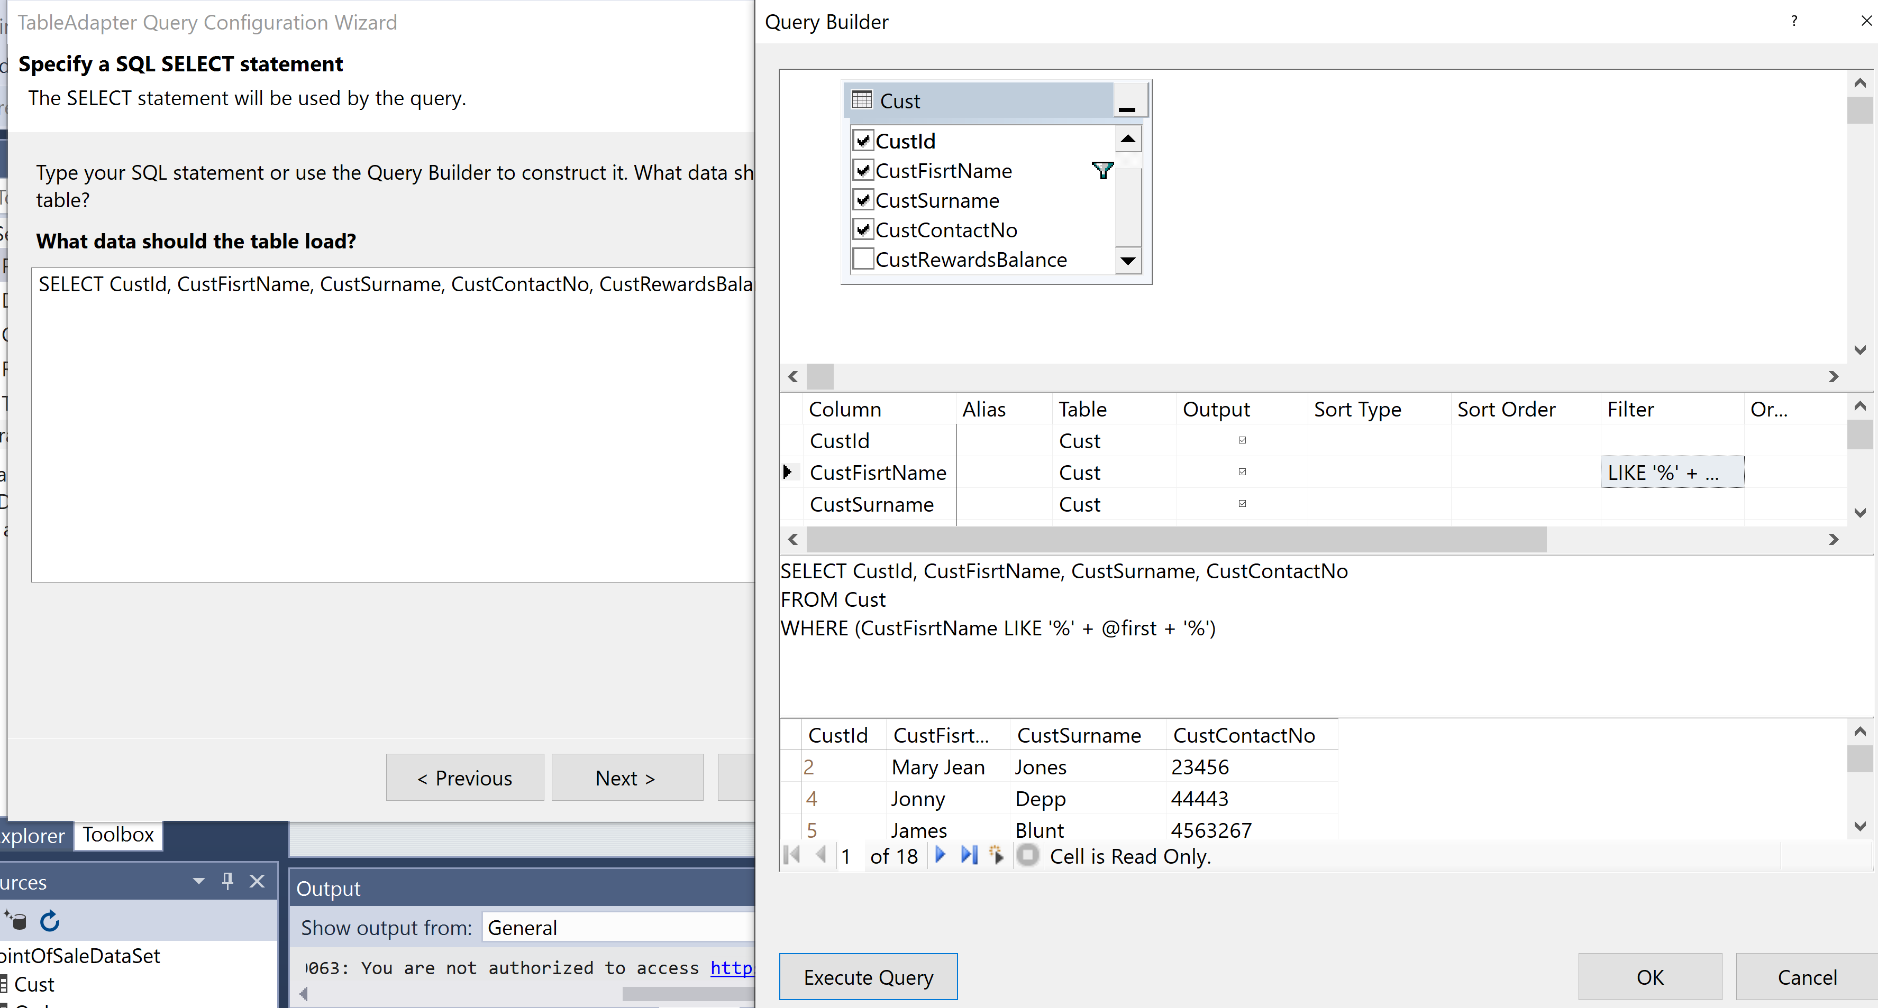

POS – DB Processing – The “Like” Query
Really cool!

Slide 15
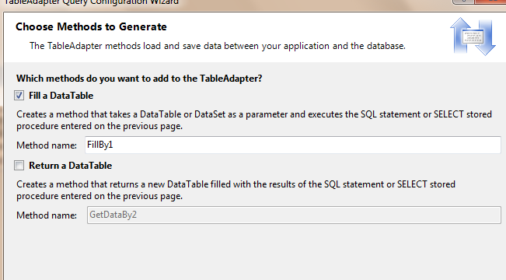
POS – DB Processing-Returning a DataTable
In the next step, the wizard presents you with 2 options in terms of where the returned data will be stored locally.
The better choice is to go for option 1.
Option1 stores the returned records into the Customer table of the existing dataset. This will take place if you invoke the method FillBy1 (or you can rename the method) shown in the illustration below
Basically what has happened is that you have added a method onto the Dataset class

Slide 16
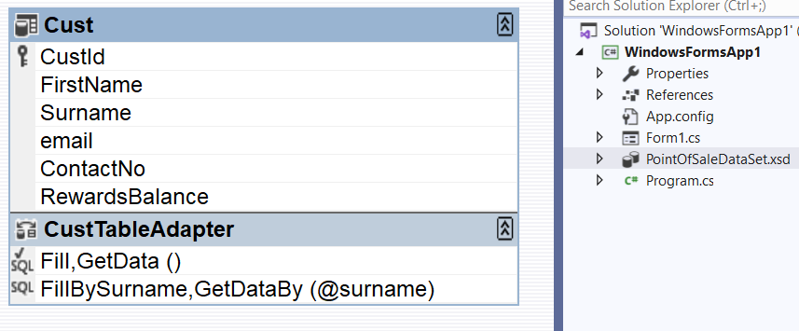
POS – DB Processing- The New DataSet
Notice the new method here – also this method has a parameter!
So when you invoke the method you have to specify the character(s) for the parameter

Slide 17
POS – DB Processing- The Customer Search List
As soon as something changes in the textbox, the gridview fills up with the corresponding customer names – just like a search engine
private void txtCustSearch_TextChanged(object sender, EventArgs e)
{
taCustomer2.FillBySurname(ds1.Cust, txtCustSearch.Text);
}

Slide 18
POS – DB Processing-Making a Selection
If the cursor is “clicked” in any row, then a table adapter that points to the Order Table in the database gets filled by all the previous orders made by the customer who has been selected in the Customer gridview
private void gvCustomer_RowHeaderMouseClick(object sender, DataGridViewCellMouseEventArgs e)
{
taOrder2.FillByCustID(ds1.Order, (int)gvCustomer.CurrentRow.Cells[0].Value);
}

